Slide 1
INFO 250 Information Visualization
Week 6A:
Projects: 2A, 2B, and 2C
Audience and questions

Slide 2
Projects to come
Project 2A: Planning of your final project (Weeks 6-7)
Project 2B: Technical implementation of your project (Weeks 8-9)
Project 2C (final): Revise and publish your project (Week 10)
These three projects follow a basic visualization workflow and will be graded based on the following criteria.
The first two projects mostly focuses on the extent to which your report covers all questions and requirements.
The final project will consider the quality of your project (complexity of data, creativity, technical soundness and cohesiveness of the story).

Slide 3
A workflow of visualization
What are you trying to do?
What are the questions to answer?
Select types of visualization
What worked well?
Who is your audience?
Generate visualizations
What didn’t?
What is the suitable data?
What do they show?
Lessons Learned
Which types of visualization?
How well do they answer the questions?
What do you expect to see?

Slide 4
Project 2A: The first step towards your final project (I)
Deadline: End of Week 7
Tasks: (We will talk about specifications of these tasks during the next few classes.)
Identify a dataset for your final project.
Describe the dataset: what it is about, and statistical descriptions of the variables that you are going to use.
Identify the target audience for your work.
Identify the questions that the audience might be curious about your data/visualization.
Design (but not implement) how your visualization will look like.
What format you are going to use? (Printed static graph? Static dashboard? Interactive dashboard? Interactive graph as a web page?)
Where do you plan to publish it?
What tool(s) are you going to use?
What types of visualization are you going to use?
What data variables are you going to use?
How are you going to map the data variables to the visual patterns?

Slide 5
Project 2A: The first step towards your final project (II)
Requirement for data:
The dataset cannot be any dataset that you have used in this class.
The dataset must have some quantitative elements that you will use in your graph (you cannot use dendrogram in your final project).
The dataset should be able to tell a story (even a simple story) comprehensively.
You are not allowed to use Raw data samples for your final project.
Be creative:
You can use data scrapping methods or APIs to directly retrieve some data from websites.
You can also collect some data manually.

Slide 6
A technical proposal should be certain and detailed
What is presented in a proposal should be certain.
A proposal is supposed to demonstrate (1) the value of an idea and (2) that you can finish the project in the proposed way.
Explorations in visualization:
As a designer, you should explore all options before making the decision.
Your proposal should be based on established decisions, and thus cannot be exploratory.
You implemented work, based on your established decision, may support exploratory use by the users.

Slide 7
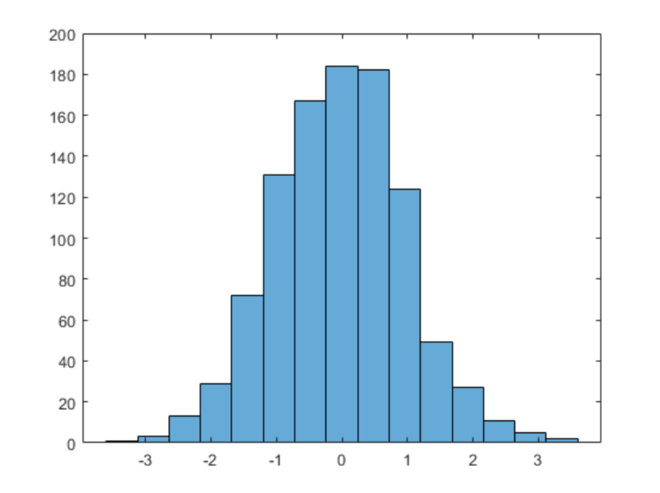
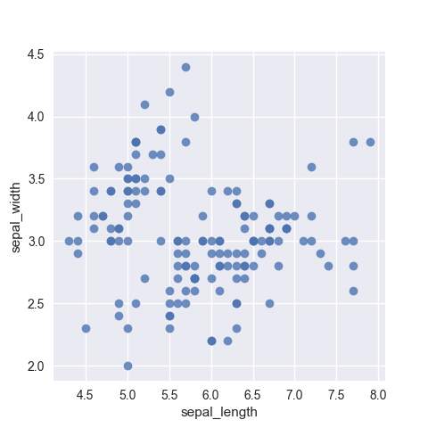
Let’s talk about questions.
Asking the questions is the first step of your visualization design.
Why questions are important for visualizations?
Almost all visualizations are guided by some intended questions.
Almost all visualizations are used to answer some questions.

Slide 8
What is a good question?
A good question
Is actionable
Is thought provoking
Is making you think differently
Is leading to new insights
Is leading to new questions
Clarifies a complex problem

Slide 9
Different types of questions
Data and visualization can answer different types of questions.
One major category of these questions is declarative (the graph gives definitive knowledge and statements to the readers) vs. exploratory (the graph help readers trying to figure out something).
This distinction is strongly connected to the interactivity of the visualization. But even in interactive visualizations, most of the questions should be declarative.

Slide 10
Brainstorming
Brainstorm method is a popular technique to get good questions.
Even though it is frequently used in a group setting, you can simulate the same procedure by yourself.
One key point of doing brainstorm is not to be deterred by wild or seemingly wrong (stupid) ideas: quantity is more important than quality, because after your mind is open, it is more likely to get really good ideas later.
Always write down what you got.

Slide 11
Know your audience
Intended audience is a factor intertwined with other aspects of visualization design, especially data and questions.
There is a somewhat one-dimensional relationship between data and audience.
Different audiences ask very different questions.
The audience needs to be considered as detailed as possible:
Saying your visualization is designed for the ”general public” is neither possible nor helpful.
Even when your work is designed for some general groups of people (sports fan or movie lovers), you still needs to understand what they know and what they care about so that your design can be guided.

Slide 12
Requirements for your final project (I)
In the targeted audience question:
You need to identify at least one key group of users who might be interested in your data and visualization.
You need to specify what they know and care about in terms of the topic of your graph. (In the form of bullet points.)
You do NOT need to use any structured method (such persona technique) but you can just make the decision based on your best knowledge.

Slide 13
Requirements for your final project (II)
About the questions that you are supposed to answer in the visualization:
You need to specify at least two questions that your identified user group might be interested in.
These questions should be as detailed as possible.
Even though they will not be graded by their meaningfulness or novelty in this assignment, being novel will be a criteria for your final project.

